Slide 1
Computer Vision:
Plant Disease Classification

Slide 2
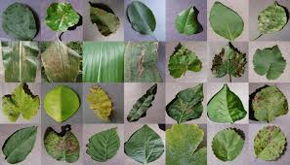
Problem Statement
Develop Deep Learning (DL) based solution which automatically help devices to detect plant, diseases. This information would be fed into the system to provide automatic remedies
Notes:
SIL level 3

Slide 3
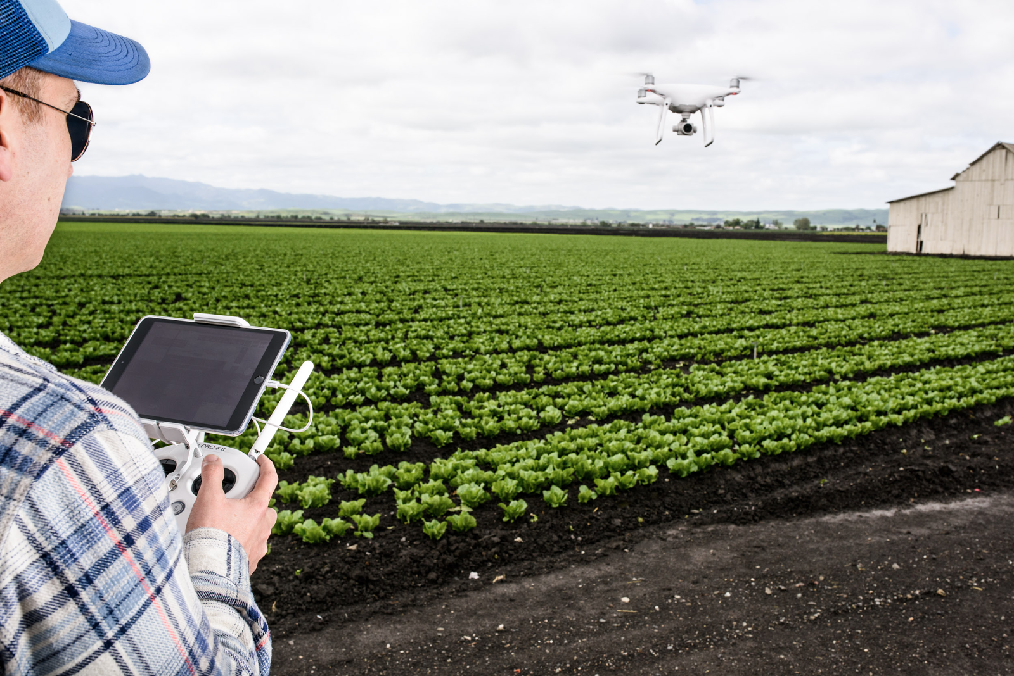
Benefits
Low cost solution that can be deployed on smartphones to detect multiple plant diseases.
Suggest realtime relevant treatment to improve the health of the plantation
Plantation images from Drones can be feed to this ML engine to detect diseases, density, soil moisture levels and relevant characteristics.
Round the clock monitoring of plants using images taken from different channels for ex: drones, satellite, camera etc.

Slide 4
Data set
Motivation
Plantation diseases remains a major threat to the supply of ever increasing demand for vegetation and a large number of crops are lost each year because of various diseases.
With smartphones around, it would be great if the smartphone could be turned into a disease diagnostics tool, recognizing diseases from images it captures using camera and suggests its treatment.
Dataset collected from https://drive.google.com/open?id=0B_voCy5O5sXMTFByemhpZllYREU
Dataset of 2 different set of data i.e. training data set validation data
Collected Training data has 38 classes of crop disease
Notes:
SIL level 3

Slide 5
Technology stack
Approach
Deep learning libraries:
Tensorflow
Keras
TensorflowJS
Scikit-Learn
Python 3.6
NodeJS
GPU - GP107 [GeForce GTX 1050 Ti]
Divided train data into train and validation dataset
Trained model tested on the testing data provided separately
Convolutional Neural Network (CNN)
Used VGG16 model architecture to train model on our specific dataset
Used Confusion matrix as accuracy matrices

Slide 6
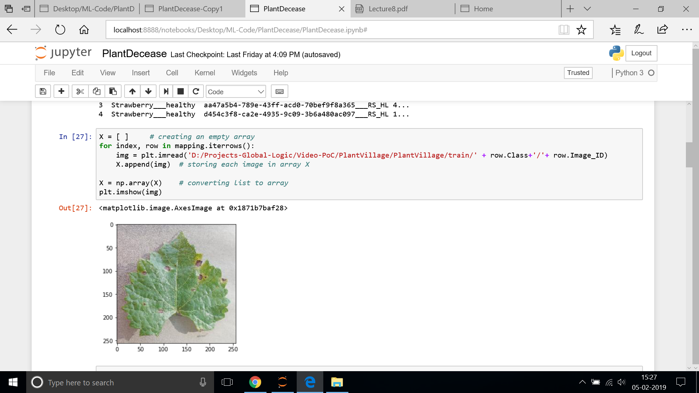
Sample Code

Slide 7
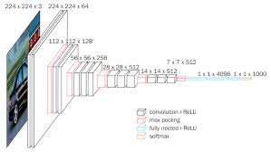
VGG 16 Architecture

Slide 8
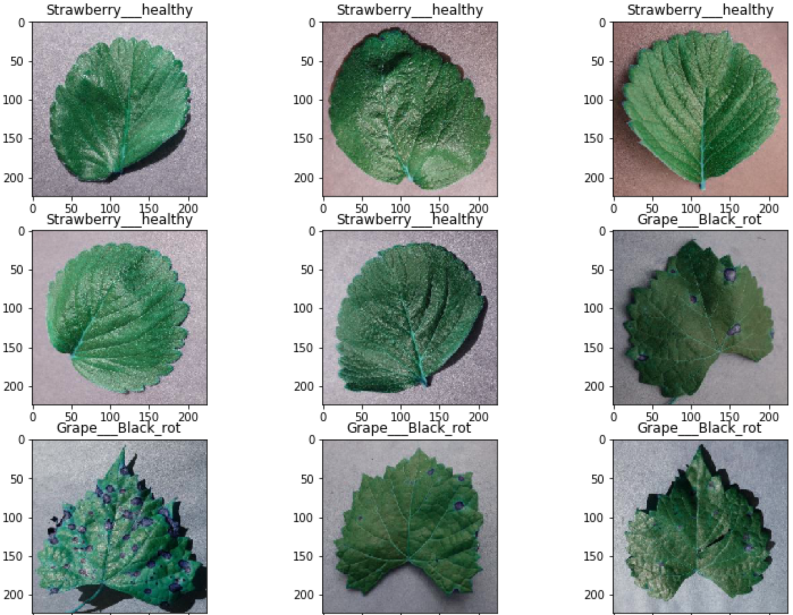
Results

